Slide 1
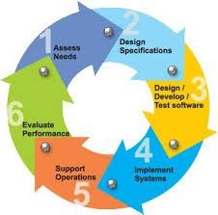
Process Models

Slide 2
Topics Covered
Software Process
Process Model
A generic Process Model
Software Framework Activities
Software Process Model
Selection of Process Model
2

Slide 3
Definition of Software Process
Software Process:
A framework for the activities, actions, and tasks that
are required to build high-quality software.
SP defines the approach that is taken as software is engineered.
Is not equal to software engineering, which also encompasses technologies that populate the process– technical methods and automated tools.
Process Model :
A Process Model describes the sequence of phases for the entire lifetime of a product. Therefore it is sometimes also called Product Life Cycle.
This covers everything from the initial commercial idea until the final de-installation or disassembling of the product after its use.
3

Slide 4
What / who / why is Process Models?
What: Go through a series of predictable steps--- a road map that helps you create a timely, high-quality results.
Who: Software engineers and their managers, clients also. People
adapt the process to their needs and follow it.
Why: Provides stability, control, and organization to an activity that can if left uncontrolled, become quite chaotic. However, modern software engineering approaches must be agile and demand ONLY those activities, controls and work products that are appropriate.
What Work products: Programs, documents, and data
What are the steps: The process you adopt depends on the software that you are building. One process might be good for aircraft avionic system, while an entirely different process would be used for website creation.
How to ensure right: A number of software process assessment mechanisms that enable us to determine the maturity of the software process. However, the quality, timeliness and long-term viability of the software are the best indicators of the efficacy of the process you use.
4

Slide 5
A Generic Process Model
As we discussed before, a generic process framework for software engineering defines five framework activities- communication, planning, modeling, construction, and deployment.
In addition, a set of umbrella activities- project tracking and control, risk management, quality assurance, configuration management, technical reviews, and others are applied throughout the process.

Slide 6
A Generic Process Model
Communication : This activity involves heavy communication with customers and other stakeholders in order to gather requirements and other related activities.
Planning : Here a plan to be followed will be created which will describe the technical tasks to be conducted, risks, required resources, work schedule etc.
Modeling : A model will be created to better understand the
requirements and design to achieve these requirements.
Construction : Here the code will be generated and tested.
Deployment : Here, a complete or partially complete version of the software is represented to the customers to evaluate and they give feedbacks based on the evaluation.

Slide 7
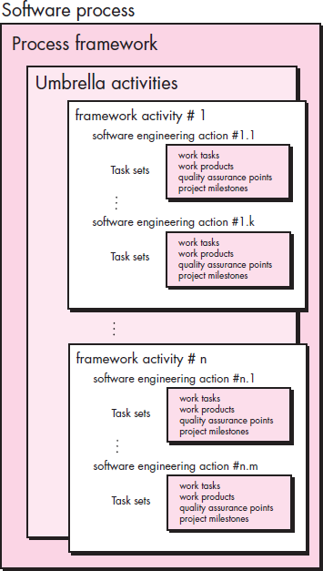
A Generic Process Model

Slide 8
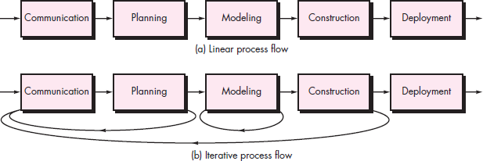
Framework Activities
Process Flow

Slide 9
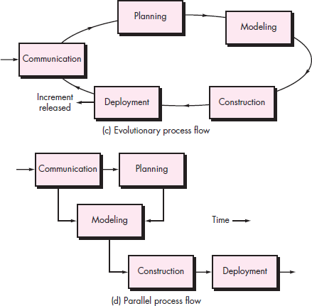
Process Flow
Process Flow

Slide 10
Process Flow
Linear process flow executes each of the five activities in
sequence.
An iterative process flow repeats one or more of the activities before proceeding to the next.
An evolutionary process flow executes the activities in a circular manner. Each circuit leads to a more complete version of the software.
A parallel process flow executes one or more activities in parallel with other activities ( modeling for one aspect of the software in parallel with construction of another aspect of the software.

Slide 11
Identifying a Task Set
For example, a small software project requested by one person with simple requirements, the communication activity might encompass little more than a phone all with the stakeholder. Therefore, the only necessary action is phone conversation, the work tasks of this action are:
Make contact with stakeholder via telephone.
Discuss requirements and take notes.
Organize notes into a brief written statement of requirements.
E-mail to stakeholder for review and approval.

Slide 12
Example of a Task Set for Small Project
The task sets for Requirements gathering action for a
simple project may include:
Make a list of stakeholders for the project.
Invite all stakeholders to an informal meeting.
Ask each stakeholder to make a list of features and functions required.
Discuss requirements and build a final list.
Prioritize requirements.
6.
Note areas of uncertainty.
12

Slide 13
Example of a Task Set for a big project
The task sets for Requirements gathering action for a big project may include:
Make a list of stakeholders for the project.
Interview each stakeholders separately to determine overall wants and needs.
Build a preliminary list of functions and features based on stakeholder input.
Schedule a series of facilitated application specification meetings.
Conduct meetings.
Produce informal user scenarios as part of each meeting.
Refine user scenarios based on stakeholder feedback.
Build a revised list of stakeholder requirements.
Use quality function deployment techniques to prioritize requirements.
Package requirements so that they can be delivered incrementally.
Note constraints and restrictions that will be placed on the system.
Discuss methods for validating the system.
13

Slide 14
Process Patterns
A process pattern
describes a process-related problem that is encountered during software engineering work,
identifies the environment in which the problem has been encountered, and
suggests one or more proven solutions to the problem.
14

Slide 15
Process Patterns
Template for describing a process pattern:
Pattern Name:
The pattern name is given a meaningful name that describe its function within software process.
Example: Customer-Communication
Intent:
The objective of this pattern is describe briefly.
Example: Intent of the communication customer to connection establish with customer.
Type:
The pattern type is specified.
Three types:
Task Pattern - action or work task
Stage Pattern – frame activity.
Phase Pattern – sequence of frame.
15

Slide 16
Process Patterns (Cont…)
Initial Context:
Describe which pattern are applies
Prior to the initialization of the pattern.
Resulting Context:
The condition that will result once the pattern has been successfully implementers are describe.
Related Pattern:
A list of process pattern that are directly related to this one are provided as a hierarchy on in some other diagrammatic form.
16

Slide 17
Software Process Model
A Process Model describes the sequence of phases for the entire lifetime of a product.
It is sometimes also called Product Life Cycle.
This covers everything from the initial commercial idea until the final de- installation or disassembling of the product after its use
All software accommodate activities.
process models can the generic framework
17

Slide 18
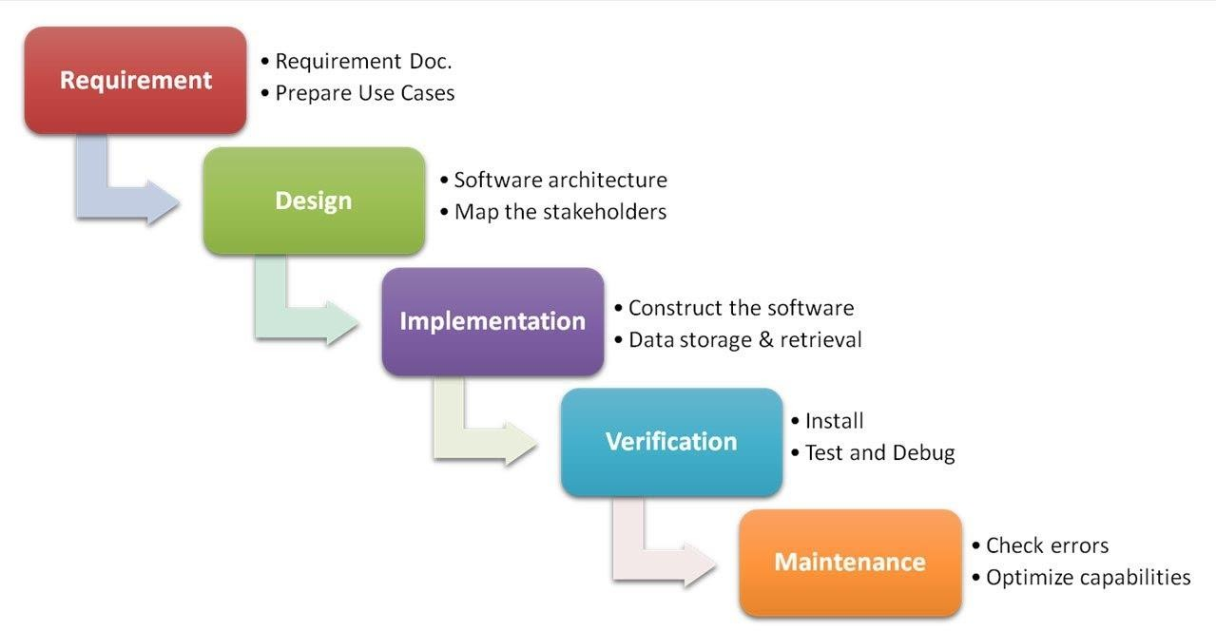
Waterfall Model

Slide 19
Waterfall Model (Cont..)
The first published model of the software development process was derived from more general system engineering processes (Royce, 1970).
This model is known as the ‘waterfall model’ or software life cycle
The waterfall model This takes the fundamental process activities of specification, development, validation, and evolution and represents them as separate process phases such as requirements specification, software design, implementation, testing, and so on.

Slide 20
Waterfall Model (Cont..)
The sequential phases in Waterfall model are:
Requirement Gathering and analysis: All possible requirements of the system to be developed are captured in this phase and documented in a requirement specification doc.
System Design: The requirement specifications from first phase are studied in this phase and system design is prepared. System Design helps in specifying hardware and system requirements and also helps in defining overall system architecture.
Implementation: With inputs from system design, the system is first developed in small programs called units, which are integrated in the next phase. Each unit is developed and tested for its functionality which is referred to as Unit Testing.
Integration and Testing: All the units developed in the implementation phase are integrated into a system after testing of each unit. Post integration the entire system is tested for any faults and failures.
Deployment of system: Once the functional and non functional testing is done, the
product is deployed in the customer environment or released into the market.
Maintenance: There are some issues which come up in the client environment. To fix those issues patches are released. Also to enhance the product some better versions are released. Maintenance is done to deliver these changes in the customer environment.
20

Slide 21
Waterfall Model (Cont..)
Problems:
Real projects rarely follow the sequential flow that the
model proposes. Although the linear model can accommodate iteration, it does so indirectly. As a result, changes can cause confusion as the project team proceeds.
It is often difficult for the customer to state all requirements explicitly. The waterfall model requires this and has difficulty accommodating the natural uncertainty that exists at the beginning of many projects.
The customer must have patience. A working version of the program(s) will not be available until late in the project time span. A major blunder, if undetected until the working program is reviewed, can be disastrous.
21

Slide 22
Waterfall Model (Cont..)
Problems:
Rarely linear, iteration needed.
Hard to state all requirements explicitly. Blocking state.
Code will not be released until very late.
Waterfall Model Application
Every software developed is different and requires a suitable SDLC approach to be followed based on the internal and external factors. Some situations where the use of Waterfall model is most appropriate are:
Requirements are very well documented, clear and fixed.
Product definition is stable.
Technology is understood and is not dynamic.
There are no ambiguous requirements.
Ample resources with required expertise are available to support the product.
The project is short.
22

Slide 23
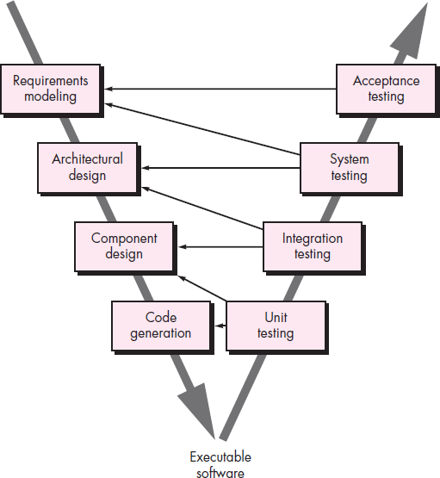
The V-Model

Slide 24
The V-Model(Cont..)
Verification Question it answers: Are we building the product right?
Validation Question it answers: Are we building the right product?
Aspect | Verification | Validation
Objective | Build the product correctly | Build the correct product
Focus | Specifications & design | User needs
Code execution | No | Yes
Type | Static process | Dynamic process
Performed during | Development | After development
Examples | Reviews, inspections | Testing

Slide 25
The V-Model(Cont..)
The V - model is SDLC model where execution of processes happens in a sequential manner in V-shape.
It is also known as Verification and Validation model.
V - Model is an extension of the waterfall model and is based on association of a testing phase for each corresponding development stage. This means that for every single phase in the development cycle there is a directly associated testing phase.
This is a highly disciplined model and next phase starts only after completion of the previous phase.

Slide 26
The V-Model(Cont..)
A variation of waterfall model depicts the relationship of quality assurance actions to the actions associated with communication, modeling and early code construction activates.
Team first moves down the left side of the V to refine the problem requirements. Once code is generated, the team moves up the right side of the V, performing a series of tests that validate each of the models created as the team moved down the left side.

Slide 27
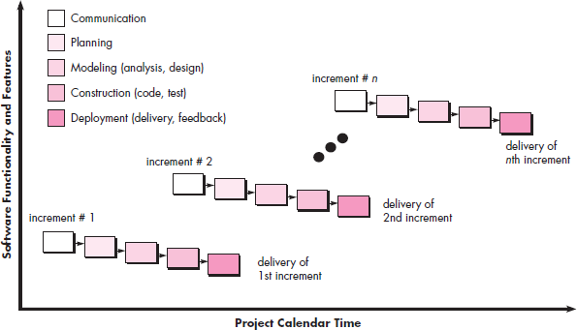
The Incremental Model

Slide 28
The Incremental Model(Cont..)
The incremental model combines element of waterfall model
applied in an iterative fashion.
The incremental model applies linear sequence like as calendar time progresses. Each linear sequence.
For Example:-
Word processing software development using the incremental
paradigm.
Basic file management, editing, document production function in the first increment.
More sophisticated editing, and document production capabilities in
the second increment.
Spelling and grammar checking in the third increment.
Advance page layout capability in the fourth.
27

Slide 29
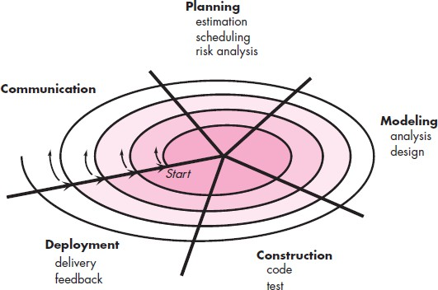
The Spiral Model

Slide 30
The Spiral Model(Cont..)
The spiral model is a evolutionary software process model that couples the iterative nature of prototyping with the controlled and systematic aspect of the waterfall model.
It provides the potential for rapid development of increasingly more complete version of the software.
A spiral model is divided into a set of framework activities defined by software engineering team. Each framework activities represent one segment of the spiral path.
Activities are implied by a circuit around the spiral clockwise direction, beginning at the center.

Slide 31
The Spiral Model(Cont..)
Concept development project
Which starts at the core of the spiral and continues for multiple iteration.
New product development
The new product will develop through a number of iteration around the spiral.
The spiral model is a realistic approach to development of large scale system and software. Because software development the process progresses.

Slide 32
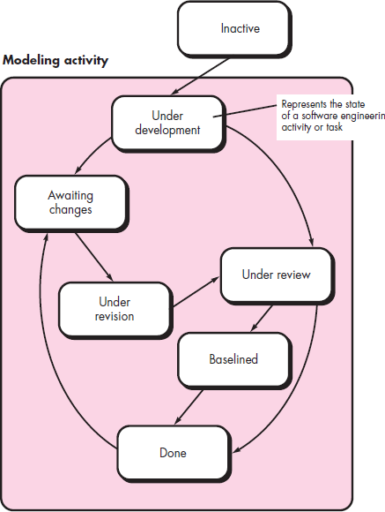
Concurrent Models

Slide 33
Concurrent Model(Cont..)
The concurrent development model - called concurrent engineering
It provides an accurate state of the current state of a project.
Focus on concurrent engineering activities in a software engineering process such as prototyping, analysis modeling, requirements specification and design.
Represented schematically as a series of major technical activities, tasks and their associated states.
Defined as a series of events that trigger transitions from state to state for each of the software engineering activities.

Slide 34
Concurrent Model(Cont..)
Often used as client/server
the paradigm for the development of
is
applications. A client/server system
composed of a set of functional components.
When applied to client/server, the concurrent process model defines activities in two dimensions :
(i) System dimension -System level issues are addressed
using three activities: design, assembly, and use.
(ii) The component dimension is addressed with two activities: design and realization.

Slide 35
Unified Process Model
Unified process (UP) is an architecture-centric, use-case driven, iterative and incremental development process that leverages unified modeling language and is compliant with the system process engineering meta-model.
Unified process can be applied to different software systems with different levels of technical and managerial complexity across various domains and organizational cultures.
UP is also referred to as the unified software development process.

Slide 36
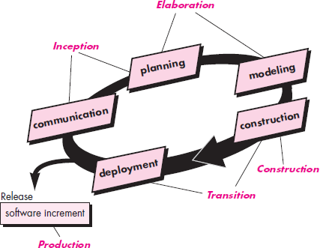
The Unified Process (UP)

Slide 37

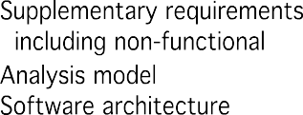
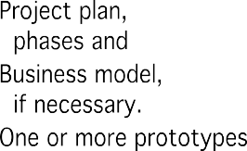
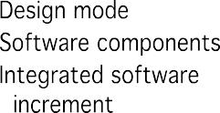



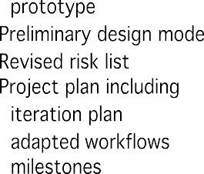

The Unified Process (UP)

Slide 38
Selection of a Life Cycle Model
Selection of a model is based on:
Requirements
Development team
Users
Project type and associated risk

Slide 39
Selection of a Life Cycle Model
Selection of a model is based on:
Requirements
Development team
Users
Project type and associated risk

Slide 40
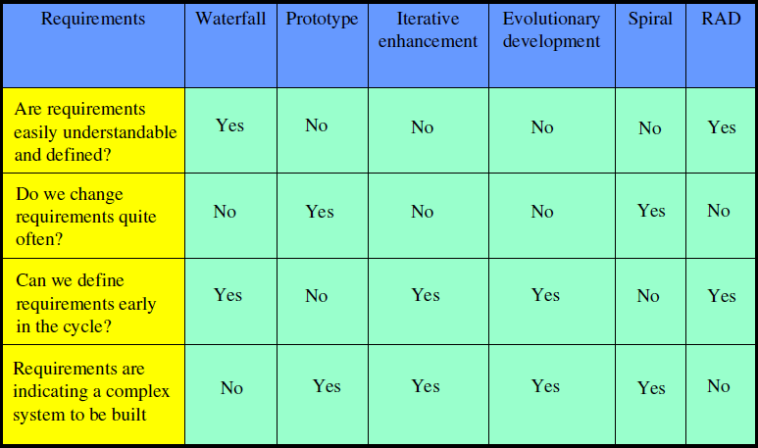
Based On Characteristics Of Requirements

Slide 41
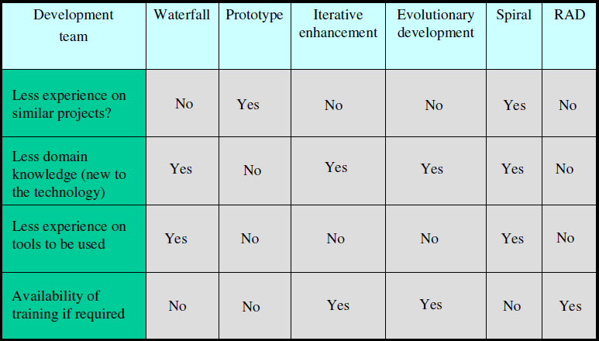
Based On Status Of Development Team

Slide 42
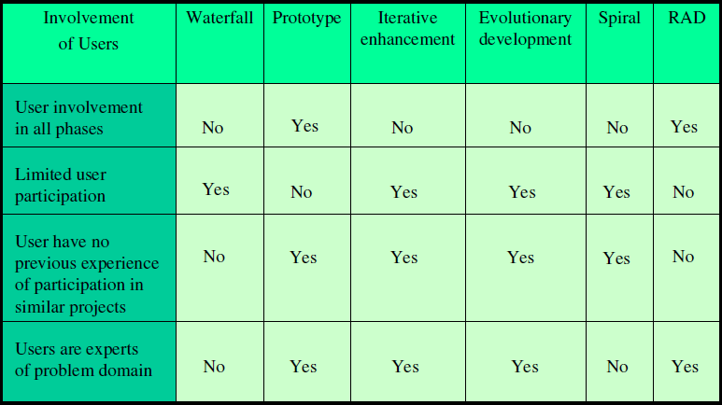
Based On User’s Participation

Slide 43
References:
Software Engineering A practitioner’s Approach
by Roger S. Pressman, 7th edition, McGraw Hill, 2010.
Software Engineering by Ian Sommerville,
9th edition, Addison-Wesley, 2011

